Slide 1



PROJECT PRESENTATION
Presented by
NEURAL CORPS

Slide 2
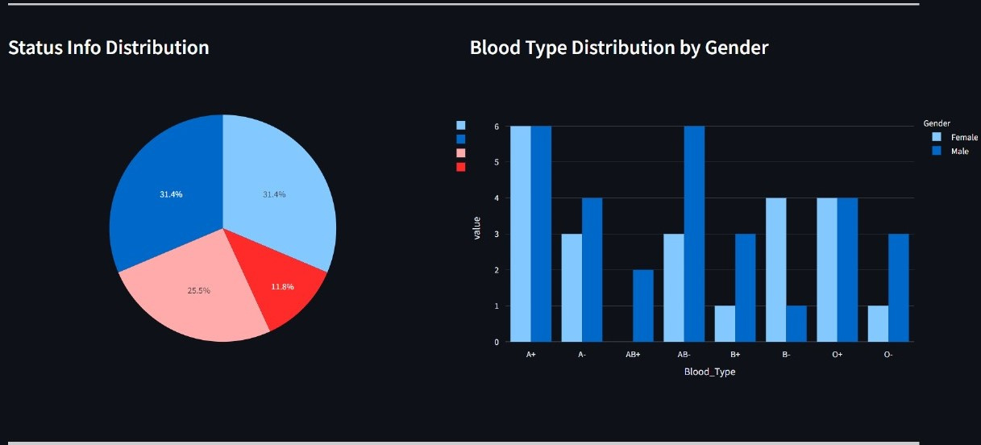
NEURAL CORPS
2
PROBLEM STATMENT
A Real Time/Live Dashboard For Enhancing Decision Making Of Hospitals And Providing Insights
BACK TO AGENDA

Slide 3
NEURAL CORPS
3
IDEOLOGY
# 1 | Help users quickly understand the current state of affairs by providing a high-level view of key metrics including value metrics and key performance indicators (KPIs).
# 2 | Track business KPIs, metrics that are relevant to your business, department, or a specific process.
# 3 | Enable you to act on that data to improve efficiency within your organization.
BACK TO AGENDA

Slide 4
NEURAL CORPS
4
1
Inefficient resource allocation, patient flow, and inventory management.
2
Data overload and disparate systems
CHALLENGES
Lack of financial management by analyzing cost patterns and identifying areas for cost reduction without compromising patient care quality
3
BACK TO AGENDA

Slide 5
NEURAL CORPS
5
NOVELTY
Inclusion of Real-Time Data Updates from the Database
Our dashboard when utilized by a group of hospitals in a locality, then we can give the right statistics based on relevant data, which in turn holds the potential for right policy making by the Government.
BACK TO AGENDA

Slide 6
NEURAL CORPS
6
Discharge Time (Wait Time)
Medical Equipment Utilization
Re- admit Patient
Patient Satisfaction
Emergency Patients Rate
Metrics based on Gender, Diseases etc.
KEY METRICS
&
INSIGHTS

Slide 7
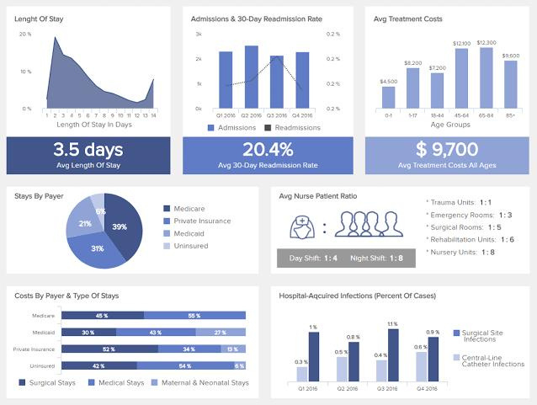
NEURAL CORPS
DASHBOARD FOR DOCTORS
7
Efficient Decision making-faster response to changing situations and patient needs.
Resource optimizations- Drug, HR, Budget.
Trend Analysis and Protective Measures.
Transparency and Accountability.

Slide 8
NEURAL CORPS
METHODOLOGY
8
# 1 | Interface for doctors/administration to input crucial patient details: demographics, medical history, current disease, age group, recovery status, and other relevant metrics.
# 2 | An Input Provision to the DataBase with appropriate Schema with respect to Hospital Management
# 3 | Delivers real-time insights into prevalent diseases, statistics, and trends
TECH STACK
Python
StreamLit
MySql Database
Plotly
Mathplotlib
BACK TO AGENDA

Slide 9
LINKS:
Our Team
Dheeraj Garnapalli
Naren Kartikeya
Laxmi Naga Mallika
Manoj Reddy
GitHub Link:- https://github.com/Dheerajgarnapalli/A-Dashboard-For-Hospital-Management.git
Streamlit Link:-
https://a-dashboard-for-hospital-management.streamlit.app/

